Slide 1
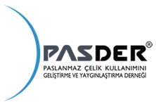
PASDER STAINLESS STEEL USE DEVELOPMENT AND EXTENSION ASSOCIATION
VIEWS REGARDING IMPORT REGIME ADDITIONAL RESOLUTION DATED 30.10.2013
VIEWS AND SUGGESTIONS REGARDING IMPORT REGIME ADDITIONAL RESOLUTION DATED 2015
MEETING PRESENTATION
ANKARA - 20.11.2014

Slide 2
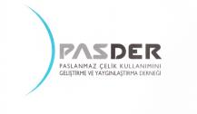
SCOPE OF PRESENTATION
Introduction of PASDER
Stainless Steel Production Process
Stainless Steel Market in the World and Turkey
Import Regime Additional Resolution dated 30.10.2013
7220 Customs Tariff Numbered Products
7219 Customs Tariff Numbered Products
Regulation Requested Regarding Import Regime Additional Resolution dated 2015
Result

Slide 3
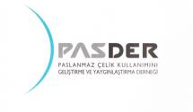
PASDER
PURPOSE: Underlining the value and importance of stainless steel, arousing interest towards this product, developing the understanding regarding stainless steel and its use and extending use of the product via transferring various sectors to stainless steel.
ACTIVITY FIELDS:
Representing the Stainless Steel industry before the State and official establishments regarding subjects related to purpose of the Association,
Supporting development of expertise and efficiency of the industry via providing necessary training and answering various technical questions,
Providing, printing and distributing brochures, catalogues and any kind of printed documents which contain relevant standards and any kind of information about stainless steel,
Arranging seminars, conferences, panels etc. which put forth the innovations of the sector, attending these organizations, announcing them to relevant parties,
Establishing relationships with establishments which have similar purposes inland and abroad and exchanging views.
PASDER is a member of European Stainless Steel Association (EUROINOX) and International Stainless Steel Forum (ISSF) in accordance with these purposes.

Slide 4
PASDER
The employees employed in establishments acting in sectors related to stainless steel especially the white appliances, automotive, food, chemistry and construction are more than 300,000 together with our members. 65% of these establishments have direct or indirect relation with our members within the supply chain.
The stainless steel amount used by PASDER members as of end of 2013 is approximately 250,000 tons/year and the added value resulting from the export they realized is more than 100 million USD/year.
It is supposed that the added value reaches 400-500 million USD/year depending on the fact that the producers available in the sectors to which PASDER members give services export 1/3 of the stainless steel amount using it within the final products of their sectors.

Slide 5
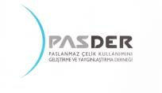
Stainless Steel Use in Turkey
Use of a total of 450,000 tons/year flat product stainless steel imported to Turkey as sectoral input is defined in the below table:
Stainless Steel Use Based on Sector (Turkey)
Sector | Use Ratio (%)
White appliances | 14.6
Kitchenware | 22.1
Chemistry-textile | 5.1
Ship industry | 3.4
Building sector | 5.1
Pipe-profile | 8.5
Automotive | 5.4
Sink industry | 6.8
Machine production | 5.1
Other | 23.9
Total | 100.0

Slide 6
Integrated Stainless Steel Production Process
Stainless Steel Service Center

Slide 7
Stainless Steel Service Centers
Stainless steel centers are important industry establishments meeting requirements of customers whose requirements are not directly met by factories with regard to producibility in terms of dimensioning and amount.
Stainless steel centers enable using the products profitably and seriously prevent loss of the national wealth.
Stainless steel centers create important employment in business lines such as planning, production, sales and marketing, export starting from the supply stage in order to meet customer requirements.
Stainless steel centers are not competitors of producers, but their most important business partner and establish added value in terms of employment, export, investment amount as much as rolling mill investment.

Slide 8
Stainless Steel Service Centers
INTRODUCTION VIDEO

Slide 9
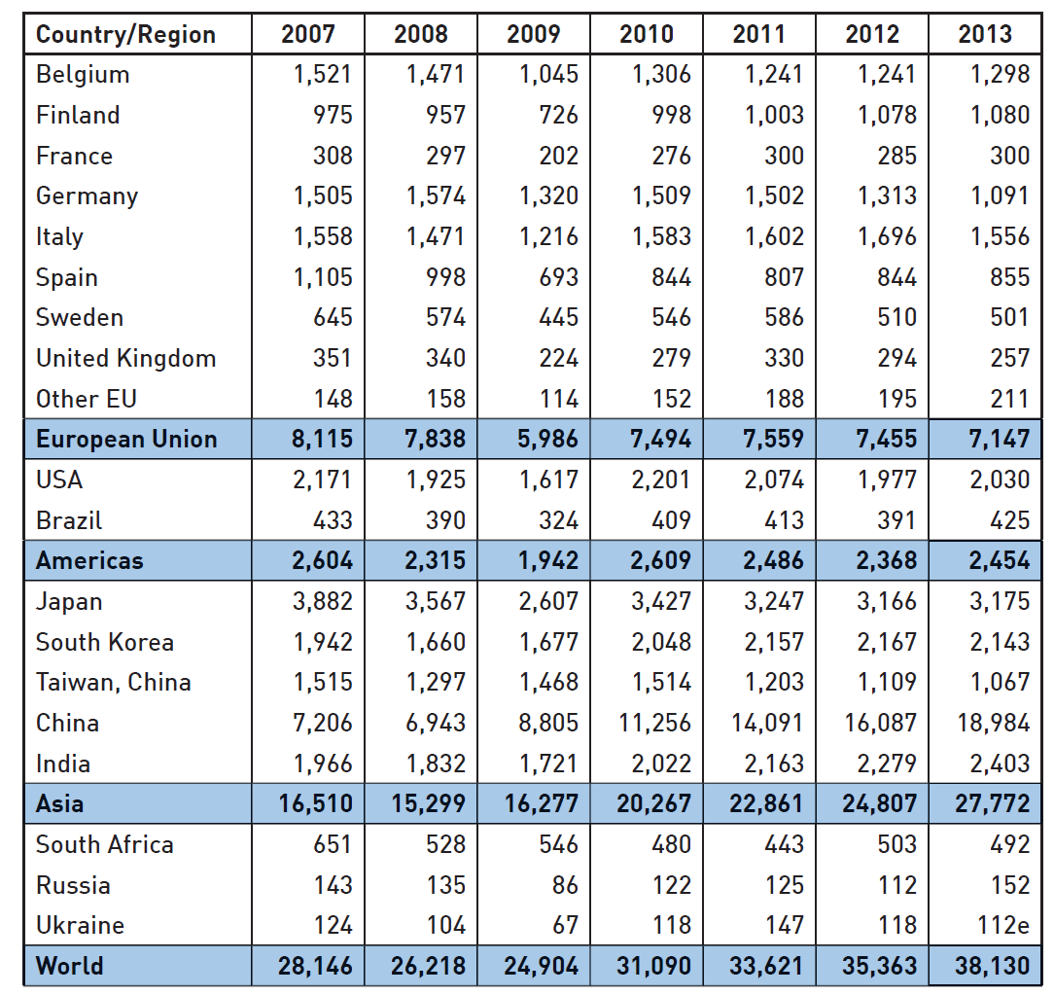
World Stainless Steel Production
Source: ISSF

Slide 10
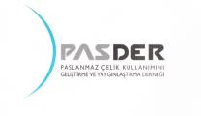
World Stainless Steel Production
Source: ISSF
Regional Distribution
(2005) (2013)
South Korean production meets 5% of the World’s production. But however, protection is implemented against 75% of the World’s production.

Slide 11
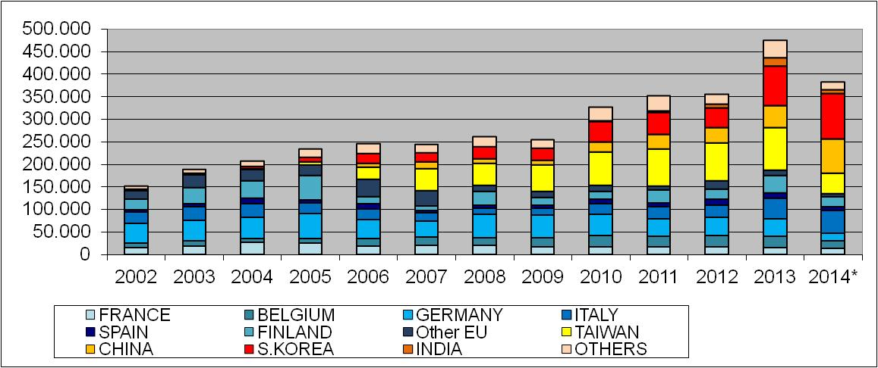
Turkey’s Flat Stainless Steel Import (m ton)
* 2014 first 9 months
Source: TUIK
10

Slide 12
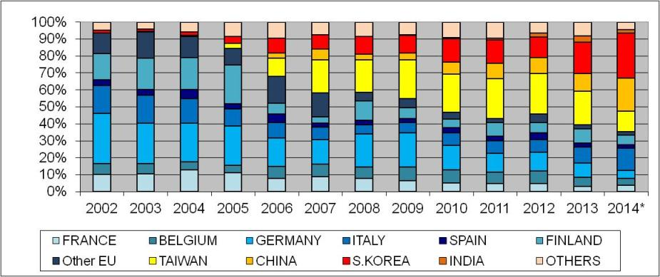
Turkey’s Flat Stainless Steel Import (% Distribution Based on Countries)
* 2014 first 9 months
Source: TUIK
The import weight of Turkey has transferred from Europe to Asia throughout the years, a serious increase occurred in the share of South Korea recently as a result of the protection established.

Slide 13
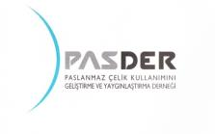
Turkey’s Flat Stainless Steel Import
Turkey’s Stainless Steel Flat Product Import (ton)
 | 2012 First 9 months | 2013 First 9 months | 2014 First 9 months
Cold Import from South Korea | 35,516 | 23,213 | 41,460
Total Cold Import | 253,301 | 278,802 | 228,458
Hot Import from South Korea | 673 | 36,576 | 59,460
Total Hot Import | 18,031 | 71,994 | 154,275
Source: TUIK
Source: TUIK
As seen, the realized protection enables a limited decrease in amount of imported cold draw stainless steel, but an increase of 78% occurred in cold draw plate imported from South Korea.
It is evaluated that the company which made cold rolling investment in Turkey imports cold rolled products and launches to the market.

Slide 14
Free Trade Agreement with South Korea
The import has constantly increased in products of which their customs tax rate has been zeroed after FTA signed with South Korea and entered into force as of 1 May 2013 and as of the end of 2013 our total import from South Korea has reached 13 times our export.
The FTA signed with South Korea turned our country into a net importer of stainless steel products and constitutes an impediment regarding production of many strategic products in Turkey.
Export of Turkey to South Korea
 | 2012 (million USD) | 2013 (million USD) | Difference (%)
Export volume | 528 | 469 | -11.2
Import of Turkey from South Korea
 | 2012 (million USD) | 2013 (million USD) | Difference (%)
Import volume | 5,660 | 6,089 | +7.6

Slide 15
South Korea’s Cold Roll Stainless Steel Import
 | 2012 First 9 months | 2013 First 9 months | 2014 First 9 months
China (ton) | 56,495 | 100,642 | 152,961
Taiwan (ton) | 21,090 | 29,022 | 32,098
Total Import (ton) | 117,628 | 180,572 | 230,421
Y/Y-1 increase (%) |  | +54% | +27%
 | 2012 | 2013 | 2014 İlk 9ay
Çin (ton) | 71.417 | 127.287 | 152.961
Tayvan (ton) | 23.503 | 35.636 | 32.098
Toplam İthalat (ton) | 94.920 | 162.923 | 185.059
Kaynak: ISSF
The cold roll stainless steel import made from China and Taiwan by South Korea which does not have any protection in its import has significantly increased during the last two years.
The share of products imported from the mentioned countries should be taken into consideration in products exported to our country by South Korea exempt from customs tax within the Free Trade Agreement.

Slide 16
Available Cold Stainless Steel Rolling Investment
The cold rolling capacity of POSCO ASSAN TST company is 200,000 tons/year and way too less than Turkey’s 450,000 tons/year consumption. Besides, since the product range is limited, it cannot meet the requirements of the market.
The added value resulting from obtaining cold rolled products from hot rolled products is approximately 5%.
Since the mentioned company imports from South Korea ¼ of its capacity directly as cold rolled final products and launches it to the market in our country, the added value resulting from investment is evenly less.
The implemented protection enables a very limited decrease in the amount of cold rolled stainless steel products imported while the amount of cold rolled products imported from South Korea has significantly increased.

Slide 17
Import Regime Additional Resolution dated 30.10.2013
Additional Resolution: 8% customs tax has been imposed on products with customs tariff number 7219 and products with customs tariff number 7220 exceeding 500 mm in width based on the resolution dated 30 October 2013 numbered 2013-5504.

Slide 18
Effects of the Customs Tax Rates Increased by the Additional Resolution on the Turkish Economy
Almost all of the companies acting in the sector no matter if they are wholesaler-retailer or producer-industrialist are SMEs with very limited possibilities.
Especially the customs tax imposed on products coded 7219 unbalanced all our companies economically, the resulting serious cost increase caused a big problem in terms of finance and many companies came to the point of getting smaller or even closing.
On the other hand, due to this mentioned customs tax increase, the producers acting within the EU increased the prices of their products exported to Turkey evenly.

Slide 19
Integrated Stainless Steel Production in Turkey
It is known that the mentioned regulation was implemented taking into consideration a possible integrated stainless steel investment. But there is no integrated stainless steel production in our country and investment is not probable due to the below mentioned reasons.
Stainless steel production requires lots of energy and taking into consideration the high energy costs in our country, it is a fact that local products cannot compete with the prices of Far East products.
All of the main raw materials of stainless steel production are insufficiently supplied in our country. Ferrochromium which is one of the main raw materials is produced very limited in our country and we do not produce nickel.
There is a serious excess in capacity of stainless steel in the world currently. According to the International Stainless Steel Forum (ISSF) data, inert capacity at a rate of 33% of the total capacity is available in the world in 2013.
Stainless steel investment cost is very high. The minimum production capacity of an integrated stainless steel production facility which will be able to replace import and compete with the global markets should be approximately 1 million tons/year. The investment amount of such a facility is approximately 8 billion USD.

Slide 20
Products with Customs Tariff No. 7220
They are products produced via being cut/sliced from materials produced in the dimensions of 1250-1500 mm standard width generally.
They are products that may be produced according to needs and requests of end users in SMEs realizing slicing and cutting procedures together with steel service centers available in our country.
Taking into consideration that through the sale of these products having the mentioned standard width dimension to our country via cutting and slicing it using workmanship of the exporter country, the added value to be obtained in our country based on workmanship stays in other countries, an additional protection is required.
Wide products will be processed by producers in Turkey and accordingly added value will be obtained and the country’s economy will be supported by increased employment through increasing the customs tax up to 12% in all articles of 7220 in order to enable the processing activities realized abroad currently to be realized inland and form added value.

Slide 21
Products with Customs Tariff No. 7220
Increasing the customs tax imposed on the mentioned products will contribute to our State in terms of taxes and will also increase the work volume, employment, export of local steel service centers and establishments doing cutting/slicing activities.
An added value of approximately 15 million USD per year stays abroad due to obtaining these products in a processed (cut/sliced) state from abroad.
By increasing to 12% the customs tax in all articles of 7220 in order to execute the processing activities realized abroad currently within our country by generating added value, the wide products will be processed by the producers in Turkey, added value will be established and the economy of our country will be supported.
As seen in the table below, the protection brought to 7219 products increased the import demand for 7220 products by 24% and accordingly caused the loss of an added value which could be created in our country.
Pos. | 2013 End of September |  | 2014 End of September
 | ton | million USD | ton | million USD
7220 | 34,674 | 81 | 42,981 | 97

Slide 22
Products with Customs Tariff No. 7219
Approximately 40% of the stainless steel products in the 7219th position are imported by PASDER member companies, turned into final products in different sectors and most of them are exported.
Since the share of these products imported with reasonable prices from Far East countries within the final products was very high before increasing the customs taxes on mentioned stainless steel products, their return to our country was also high, but after the precautions taken in terms of protection, the prices in our country has exceeded the prices in the world.
This situation has negatively affected the competitiveness in export and market share of many companies from different sectors such as automotive, white appliances, kitchenware, construction, chemistry, machine production and industrial production which use stainless steel as input and play an important role in export.
The cost increases occurring in products consumed inland due to the same reason create an inflationary pressure and at the same time set ground for import of final products produced abroad.
The 8% protection brought to the stainless steel sector does not benefit the industry of the country, harms the competitiveness of industries where these products are used as intermediate goods, leads up import while preventing export.

Slide 23
PASDER Views
The industry sector corresponds to 17% of the national income in terms of revenue. As of the end of 2013, taking into consideration the national growth equivalent to 4.1% in terms of production;
Banking and finance 1.3
Trade 0.6
Transportation and storage 0.5
Construction 0.4
has contributed in total with 2.8 points to this growth, while the following has contributed as follows;
Manufacturing industry 0.9
Agriculture 0.3
The table above shows how restricted remains the manufacturing sector before the service sector, that the SMEs which form 98% of the manufacturing industry and are its backbone should be supported no matter what the conditions are.

Slide 24
PASDER Views
For today, the average price of chrome-nickel alloyed stainless steel cold products used widely in Turkey and purchased from the Far East is around 2,400 USD/ton. Together with the customs clearing expense of approximately 2%, the cost of the mentioned material becomes 2,450 USD/ton. Taking into consideration that the price of the contract manufacturer company in our country for the same quality is 2,700 USD/ton, there is an additional cost of 250 USD/ton load on our industrialist.
The mentioned company significantly increases its profit rates by keeping the sale prices high as a result of the difference created in its favor through the 8% customs tax factor.
1 year or more maturity purchase may be realized from other countries in the Far East, and this payment type enables SMEs to minimize their financing expenses in order to forward-purchase the materials and export the final products.
The cheaper we procure the necessary products obliged to be imported to our country where an important part of energy is imported and raw material sources are not sufficient, the more our industrialists and accordingly our people will earn.
The competitiveness of industry depends on acquiring the raw materials with the global prices. The current situation leads to the cost of an industrial input which does not have an actual production in our country to be much higher than the global prices.

Slide 25
Result
After the protection imposed on cold draw products, the fact that Posco-Assan TST Steel Industry Inc. imports (from controlling shareholder Posco) hot draw products and turns them into cold draw products, has made it the only company which does not get affected by the protection and caused it to be dominant.
While the low input cost we had using the price advantage of some Far East countries with customs tax rates before the mentioned regulation supported our industrial production and export, increase of input costs due to increase of customs tax caused negative effects on the Turkish industry such as cost increase, decrease in capacity use rates, decrease of employment and export.
With this regime and precaution; presenting suggestion within DIR to complaints regarding making stainless steel users dependent on a company which;
has quality problems,
does not meet deadlines,
has limited product range
is not a solution for producers giving services to local markets.
In order to eliminate all of these mentioned negative effects; exempting products with customs tariff number 7219 from customs tax and increasing customs tax rates of products with customs tariff number 7220 are deemed as the most convenient solutions for the economy of the country.

Slide 26
Regulation Requested Regarding Import Regime Additional Resolution dated 2015
COMMERCIAL DEFINITION OF GOODS | G.T.I.P. NUMBER | CURRENT CUSTOMS TAX RATE (%) | REQUESTED CUSTOMS TAX RATE (%)
Thickness is 4.75mm or more | 7219.31.00.00.00 | 8 | 0
Contain 2.5% or more nickel in terms of weight | 7219.32.10.00.00 | 8 | 0
Contain less than 2.5% nickel in terms of weight | 7219.32.90.00.00 | 8 | 0
Contain 2.5% or more nickel in terms of weight | 7219.33.10.00.00 | 8 | 0
Contain less than 2.5% nickel in terms of weight | 7219.33.90.00.00 | 8 | 0
Contain 2.5% or more nickel in terms of weight | 7219.34.10.00.00 | 8 | 0
Contain less than 2.5% nickel in terms of weight | 7219.34.90.00.00 | 8 | 0
Contain 2.5% or more nickel in terms of weight | 7219.35.10.00.00 | 8 | 0
Contain less than 2.5% nickel in terms of weight | 7219.35.90.00.00 | 8 | 0
Width more than 500mm less than 600mm | 7220 (all) | 8 | 12
Width less than 500mm |  | 0 | 12

Slide 27
THANK YOU

